Slide 1


SOMERSET PURPOSE
Somerset Academy, Inc. promotes a transformational culture that maximizes student achievement and the development of accountable, global learners in a safe and enriching environment that fosters high-quality education.
S - Set high expectations
O - Objective
M - Meaningful curriculum
E - Effective
R - Resourceful and responsible life long learners
S - Scholars who achieve proficiency and beyond
E - Evaluate continuously and use data to drive curriculum
T - Teachers who are highly qualified

Slide 2

DO NOT. . .
“Hang out” in the stairwells or on the second floor during lunch.
Chew gum. DO NOT BRING GUM!
Go on the basketball court with a skateboard!
Use the elevator without approval from the office.
Leave campus if you are a Middle Schooler, Freshman or Sophomore (Except for DE students)
Allow an underclassmen in your vehicle without prior permission, or you will lose all privileges for the remainder of the school year.
Throw anything off the balcony.
Throw anything from the ground level to the 2nd floor.
Eat or carry food over the basketball court or turf field
Litter or leave garbage around at lunch
Hang out by the wavy wall side or behind the basketball court bleachers
Hang on or grab the basketball nets/rims
Playing “keep away” = a detention
Yoga pants/ leggings/ are not allowed. Not even during dress down days. Dress code violations earn detentions
You are not to go to the Deans’ office during class to argue a detention. You will be turned away.

Slide 3
Discipline
Discipline is applied with mutual respect in a firm, fair , reasonable and consistent manner.
Preventive Morning announcements, Teacher and School's Rules & Expectations
Supportive Warnings for students to get back on task. Email notification to parents
Corrective Weekly Monday Detentions, Monthly Saturday Detentions

Slide 4

No Cell Phones Off and away the entire day
1st Violation – Detention
Parent notification submit phone to main office
2nd Violation – Saturday Detention
Parent notification submit phone to administration
3rd Violation – Referral Suspension & Behavior Probation
Device must be picked up by a legal guardian

Slide 5
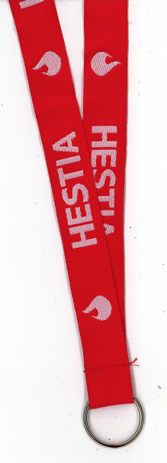
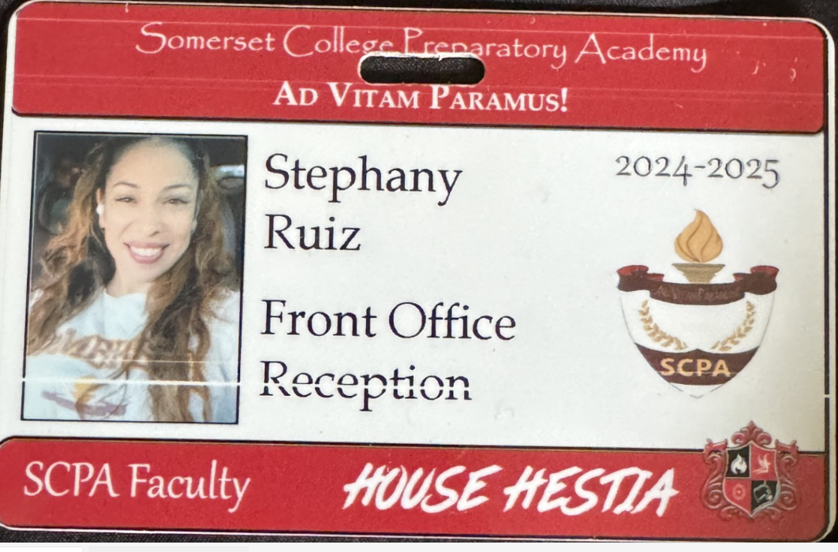
Lanyards and IDs are a Mandatory Part of your uniform
Keep in your backpack
Needs to be worn everyday you’re at school
No Lanyard and ID will result in a dress code violation.
Purchase in Front Office
Lanyard $3
ID $2 (Cash Only)

Slide 6


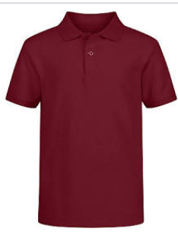
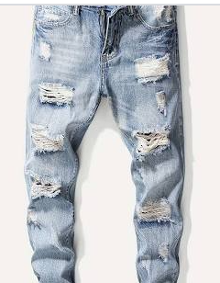
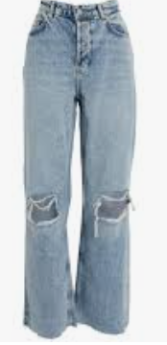
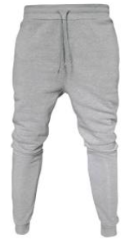
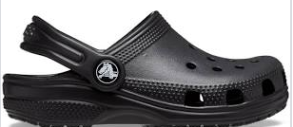

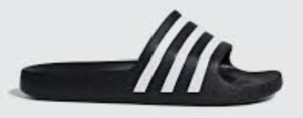
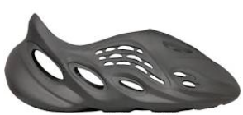
Dress Code Violations (Do Not Wear)
Ripped or Frayed Jeans
Non - Somerset, Hoodies or Polos
Crocs, Slides & Foam Runners
Sweatpants, Joggers, Yoga pants, tights or Pajama pants

Slide 7
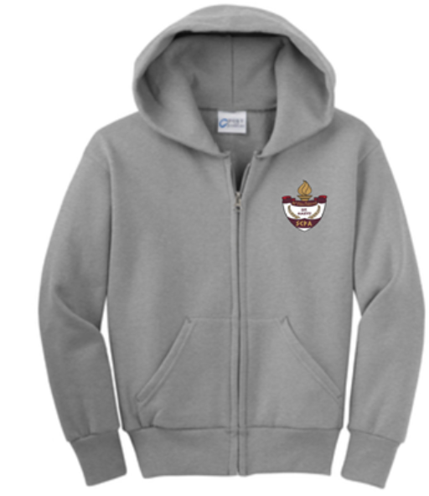
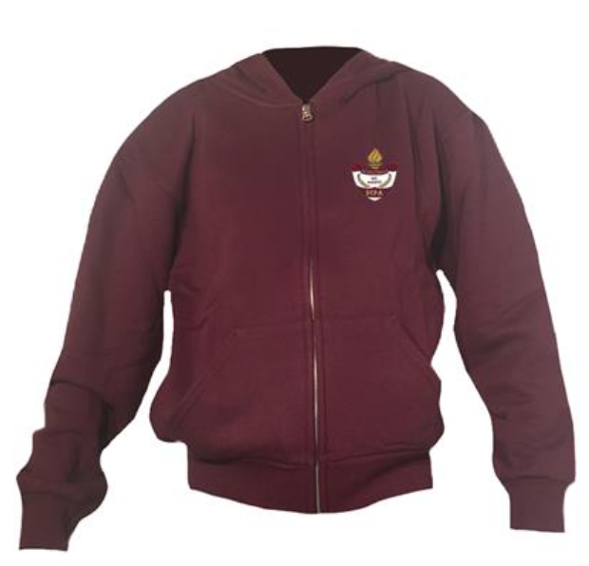
Dress Code Violations
A Somerset College Prep shirt must be worn underneath a zip up Hoodie or Jacket.
Exceptions would include
House Shirts on Thursday's
School Friday Shirts
Club Shirts
School Athletic apparel for game days.
Anyone not in compliance will be given a Dress Code Violation according to our Discipline Matrix.

Slide 8
Discipline Matrix (Uniform Violation)
Lunch Detention
Saturday Detention
Saturday Detention. 9:30am to 12:30pm
Monday Detention
Suspension
2 Day Suspension
Referral 9-week behavior probation contract.
1 Day suspension
Referral
Student not welcomed back following year.
2 Day suspension
1st Offense
2nd Offense
3rd Offense
4th Offense
5th Offense
Every Friday
12:00 – 12:30
Detention slip will allow
Student access to front of
lunch line
Every Monday afterschool. 3:50pm to 4:50pm in cafeteria
Tuesday if school is closed Monday

Slide 9
Somerset College Prep Discipline Matrix
*Warnings* Do Not apply to all discipline. Teacher & Staff discretion
DETENTION
SATURDAY DETENTION
SUSPENSION including DISMISSAL
3:50 to 4:50pm
Classroom Disruption
Disruptive Conduct
Chewing Gum
Bus Violation
Disrespect for others or property
Uniform Violation
Littering during lunch
Electronic Confiscation
Public Display of Affection / P.D.A
Profane Obscene Abusive Language
Running in the Halls
Spray used in the Restrooms
Tardy to Class
Tardy to School ( 3 late arrivals non bus rider)
Excessive Detentions / Unserved Detention
Theft
False or Misleading Info
Open Defiance of Authority
Vaping / Alcohol
Physical Altercation
Fighting or Attempting to Fight
Assault / Intimidation Threat of Student
Weapons
Other Major Misconduct
9:30 to 12:30pm
Horseplay
Missed Detention
Multiple Detentions
Disruptive Conduct
Bus Violation
Skipping = 2 Saturday Detentions, Referral & 9 week Behavior Probation Contract
Cheating = 3 Saturday Detentions, Referral & Behavior Probation Contract

Slide 10
Somerset Discipline Matrix
Lunch Detention
Saturday Detention
Saturday Detention. 9:30am to 12:30pm
Conceirge email sent to parents
Monday Detention
Suspension
2 Day Suspension
Referral 9-week behavior probation contract.
1 Day suspension
Referral
Student not welcomed back following year.
2 Day suspension
1st Offense
2nd Offense
3rd Offense
4th Offense
5th Offense
Every Friday
12:00 – 12:30
Conceirge email notification
Sent to parents
Detention slip will allow
Student access to front of
lunch line
Every Monday afterschool. 3:50pm to 4:50pm in cafeteria
Tuesday if school is closed Monday

Slide 11
Missed Detention Consequences
Missed Lunch Detention = Afterschool Detention
Missed Afterschool Detention = Saturday Detention
Missed Saturday Detention =
2 – Day Suspension
Referral & Behavior Probation

Slide 12


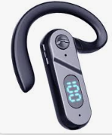

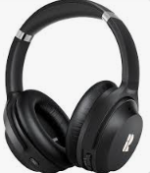

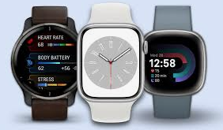
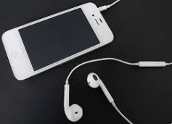
No Wireless Communication Devices
Off & Away for the entire day
No Devices
Smart Watches, Earphones, Tablets

Slide 13
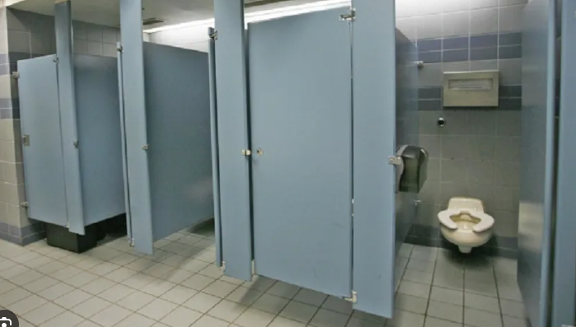
ONE (1) Student in a Stall at a time!
This includes the Large Stall!!
Consequences will be distributed.

Slide 14
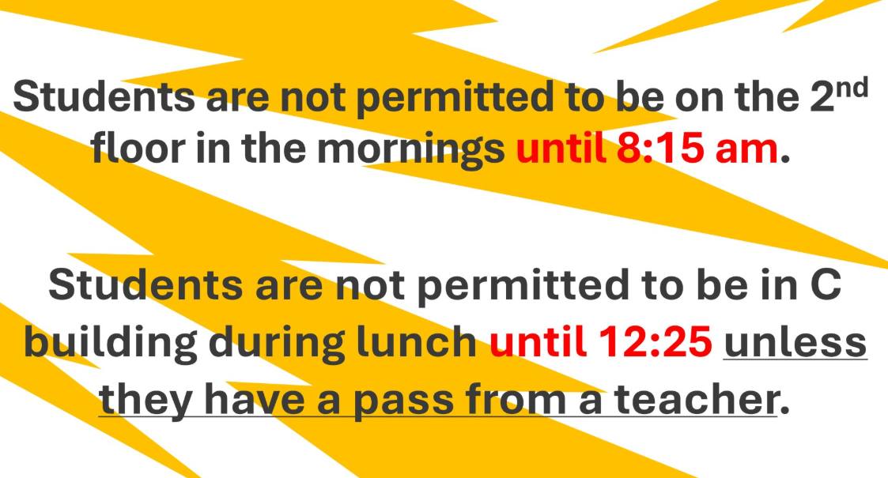

Slide 15
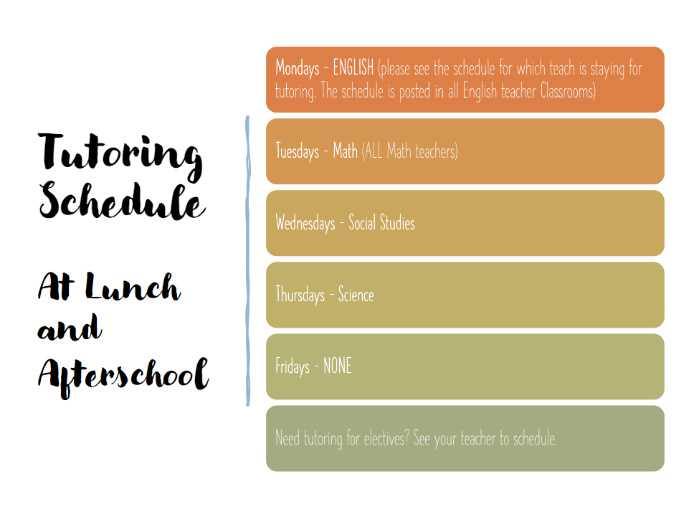

Slide 16
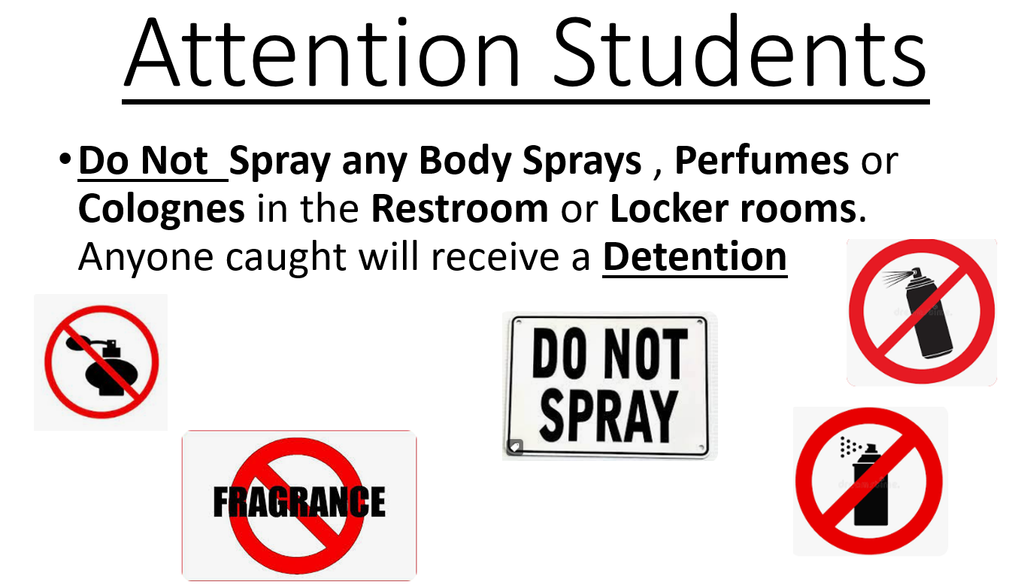

Slide 17
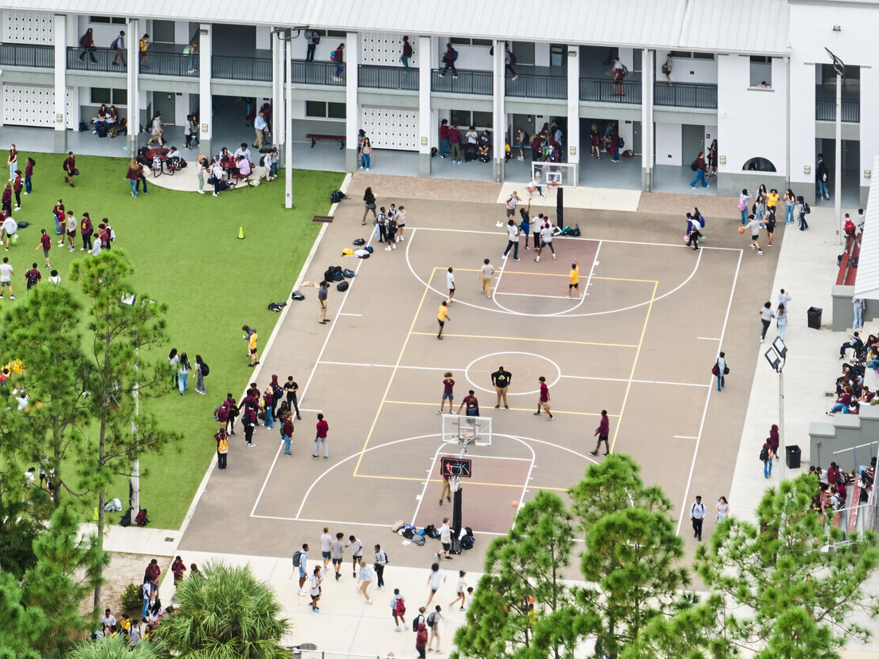
NO FOOD or drink ON THE COURT

Slide 18
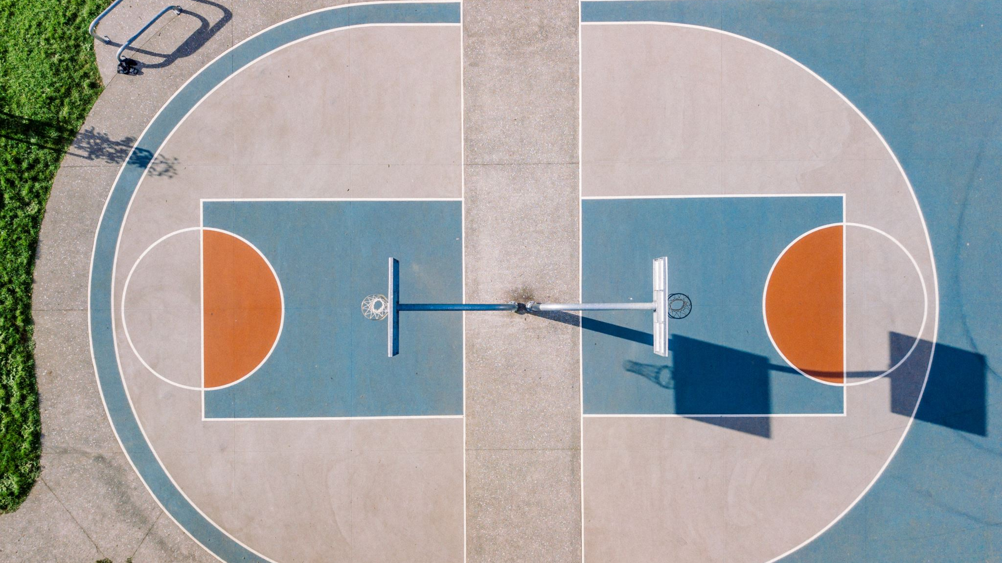
on basketball courts OR turf without a staff member present (This means mornings & after school too.)
NO Playing ANY SPORTS

Slide 19
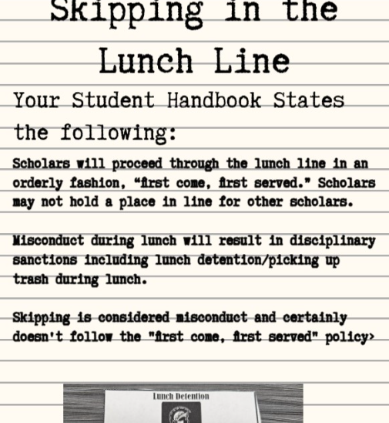


Slide 20
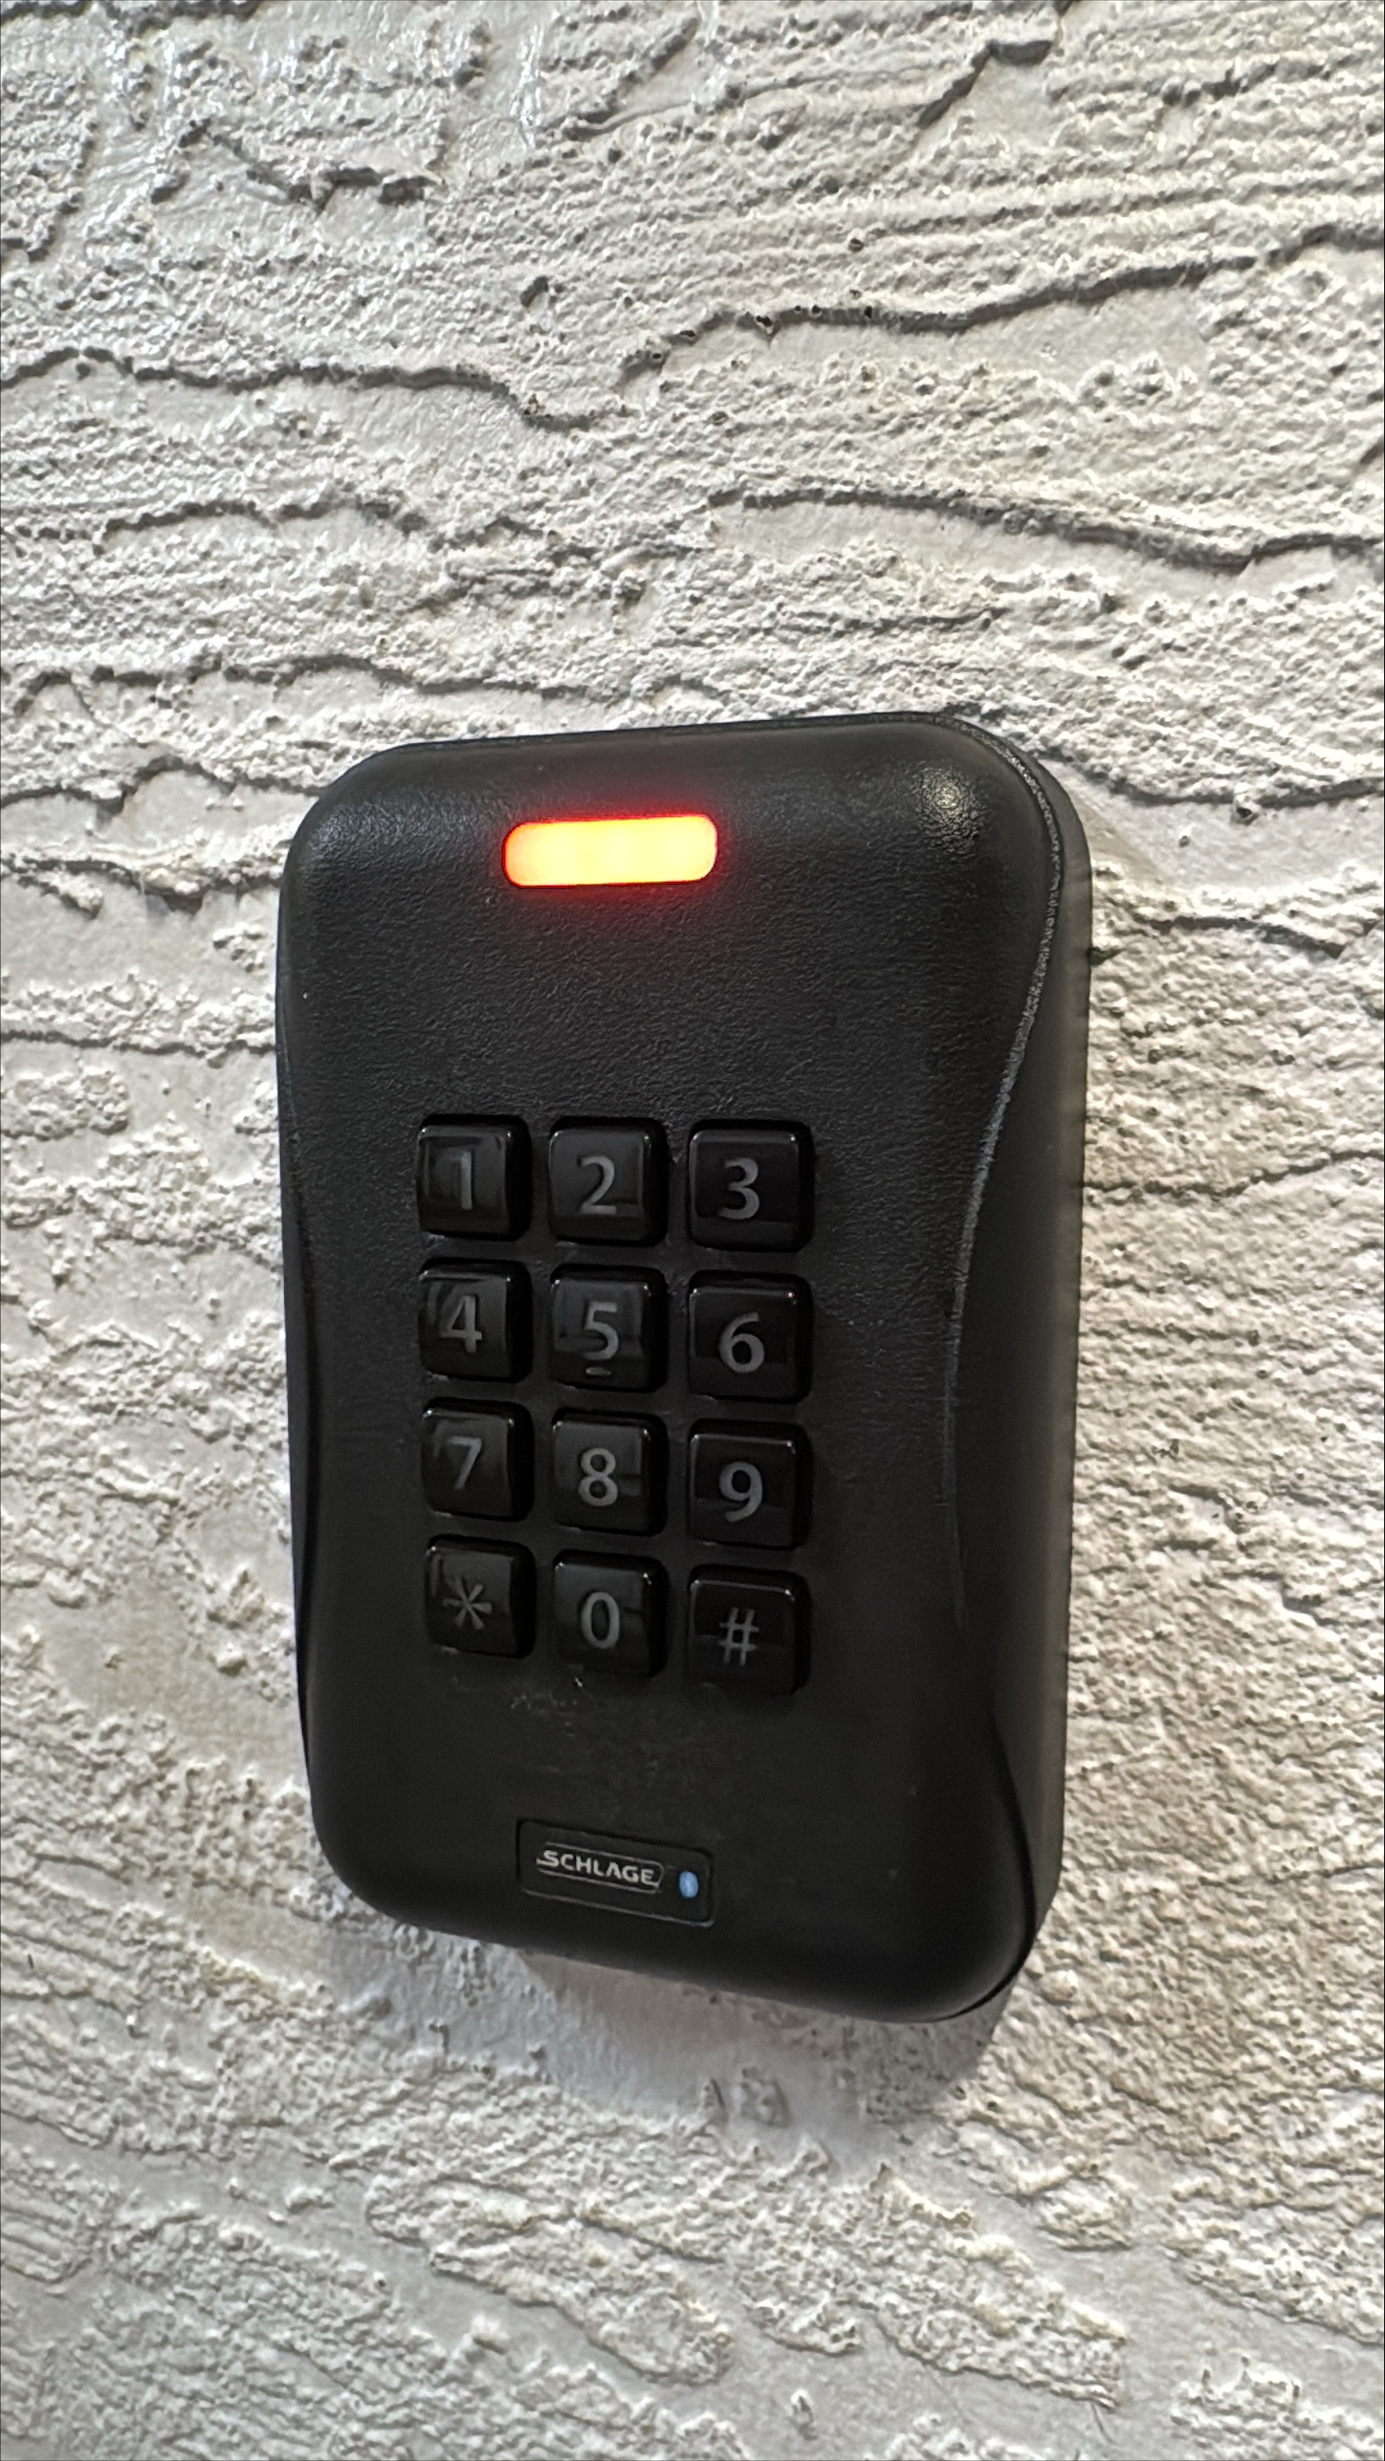

Quick Tips From the IT Department
New student's lunch numbers will be entered and working by the end of this week. Students can use their lunch number on keypads to enter student areas.
All student passwords have been reset! New passwords are in the following format: MMDDYYYYfl
Where MMDDYYYY is your birthday, and fl is your first initial + last initial. Ex: 06112009jd
New student logins can be found by going to https://colegia.org/student/lookup, selecting St. Lucie County, and entering the student's 562#.
Any questions? Please email support@somersetcollegeprep.org for IT support.

Slide 21

Tell an adult in our school!

Slide 22

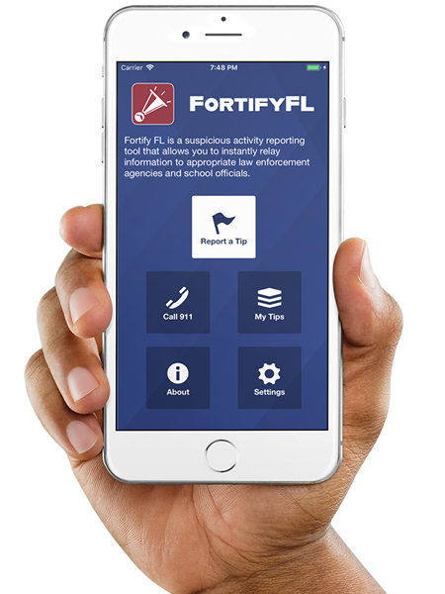
Anonymous Reporting App

Slide 23
ATTENTION STUDENTS!!
Did you know that the Florida Department of Law Enforcement and the Florida Department of Education created an anonymous reporting App that allows you to instantly send information about suspicious activity to local law enforcement and school officials?

Slide 24
WHY?
It is important to always remember that If You See Something, Say Something! With FortifyFL, you can easily submit information about potential crimes or threats which will immediately be forwarded to law enforcement and designated school personnel.

Slide 25
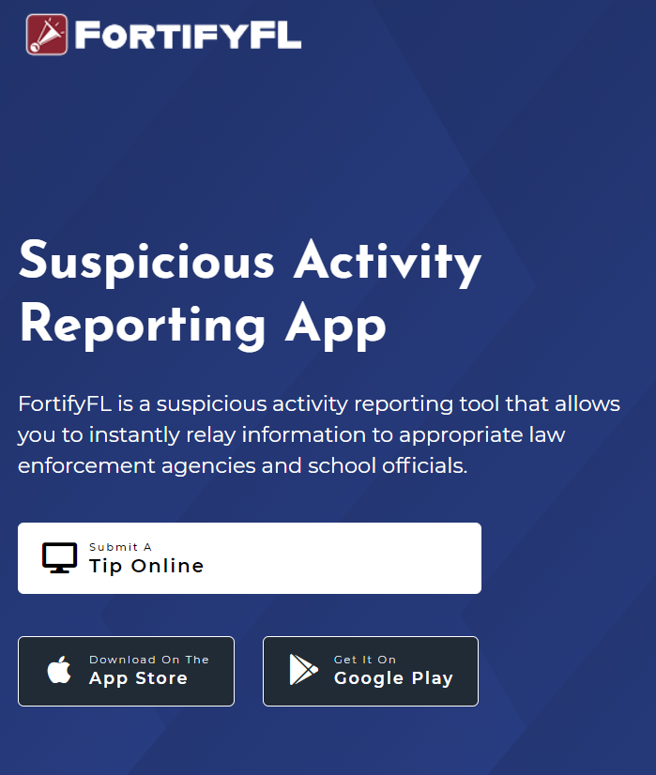
HOW DO I SUBMIT A TIP?
You can submit a tip from any computer at: https://getfortifyfl.com/

Slide 26
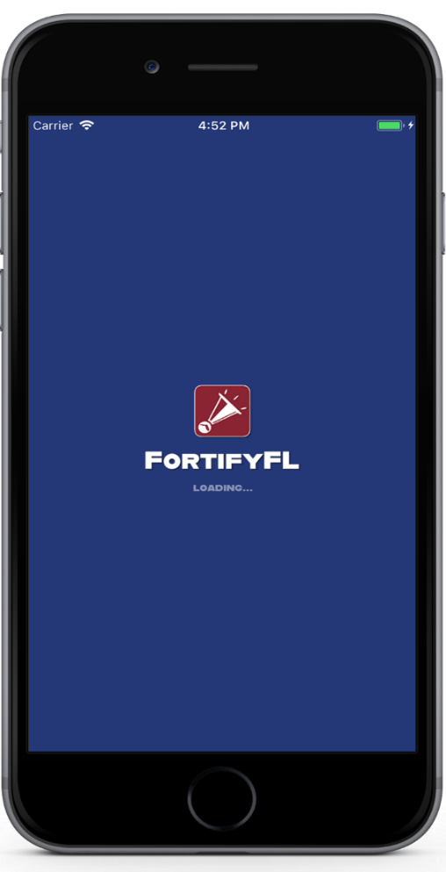

HOW DO I SUBMIT A TIP?
You can also submit a tip using your cell phone. Download the FortifyFL App on your mobile device.

Slide 27
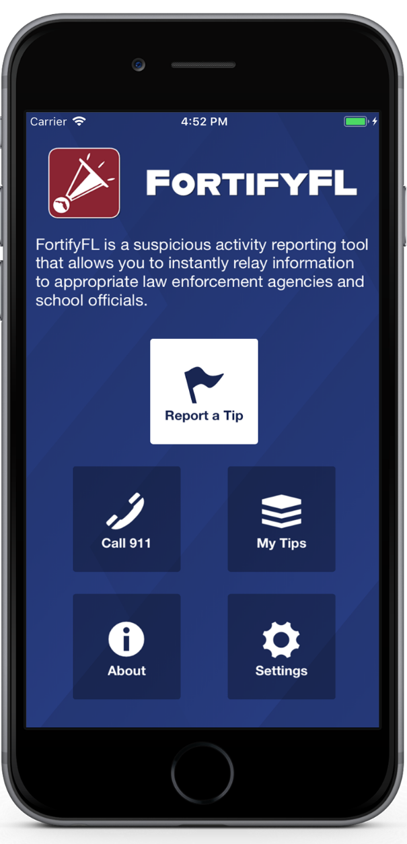
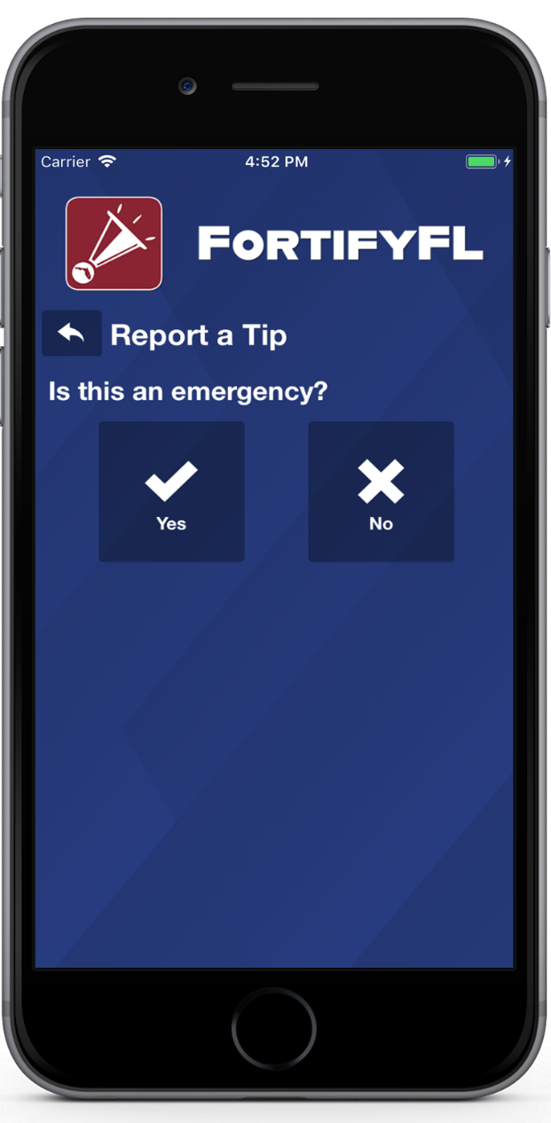
HOW DO I SUBMIT A TIP?
Click “Report a Tip,” and indicate if it is an emergency

Slide 28
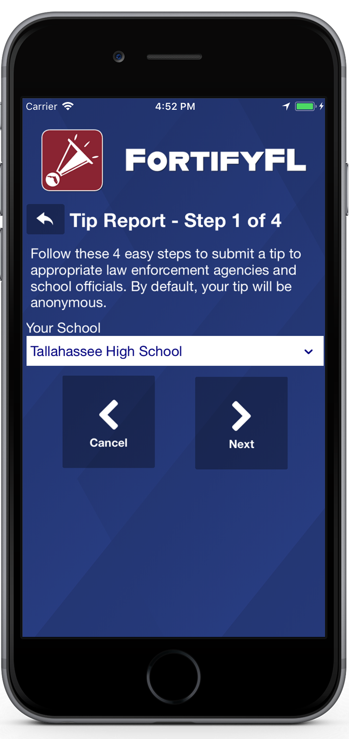
HOW DO I SUBMIT A TIP?
Step 1: Select Your School

Slide 29
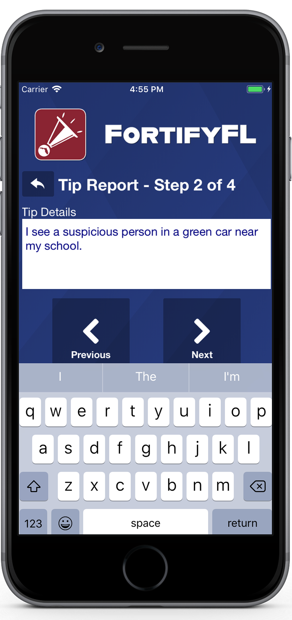
HOW DO I SUBMIT A TIP?
Step 2: Provide Your Tip

Slide 30
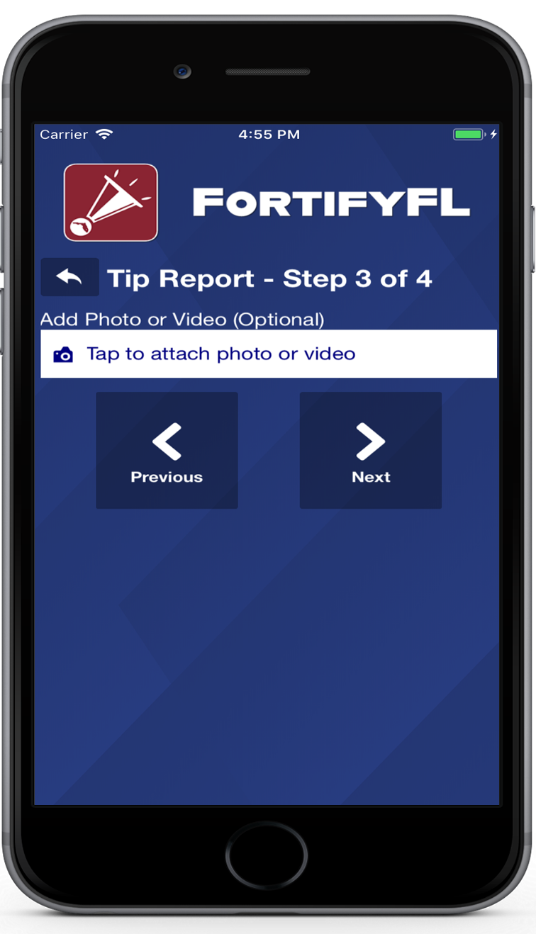
HOW DO I SUBMIT A TIP?
Step 3: Attach an Optional Photo or Video

Slide 31
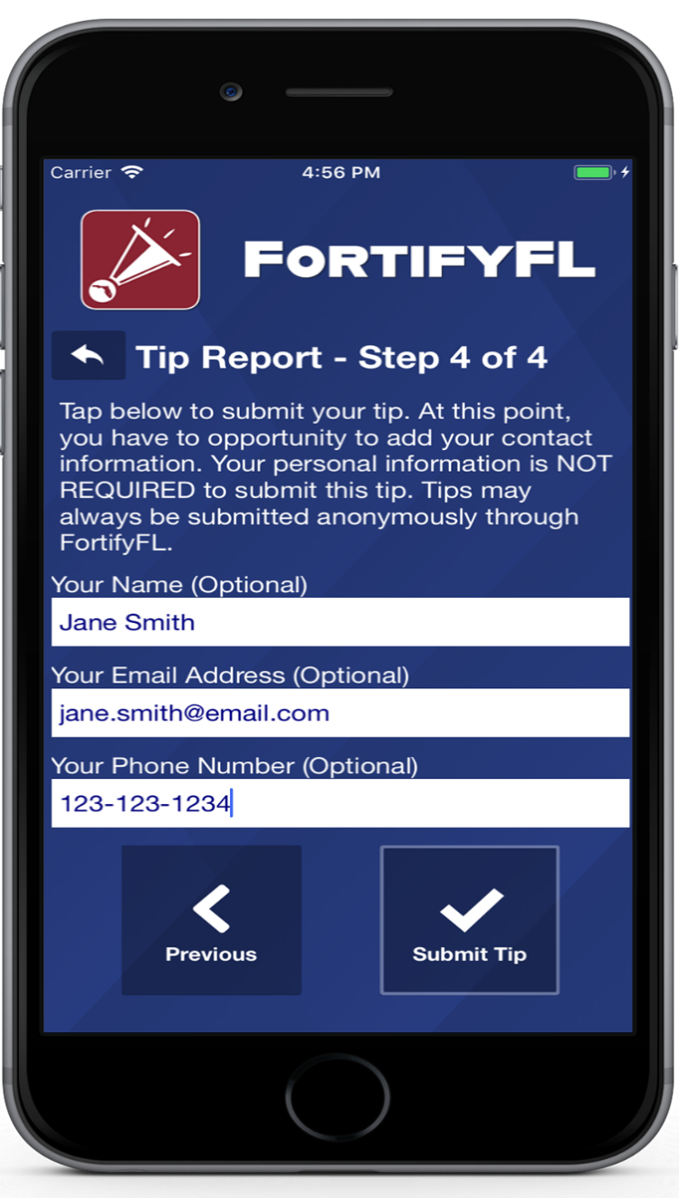
HOW DO I SUBMIT A TIP?
Step 4: Provide Optional Information and Submit Your Tip

Slide 32
False Tips Lead to possible Criminal penalties
If someone who knowingly submits a false tip through FortifyFL may be subject to further investigation by law enforcement, and may be subject to criminal penalties under Section 837.05, F.S.

Slide 33

Lanyard Policy! -Do NOT WEAR ANOTHER STUDENT’S ID (It’s basically fraud and you’ll get a referral)
Rule:
Worn around neck ONLY
Consequence
pocket/bookbag = detention

Slide 34


Slide 35


Slide 36

College Campus Tour! FIT and UCF on April 23!
Juniors and Seniors! Take a tour of both FIT and UCF’s campuses.
Permission slips are in the office and must be returned by April 10. Don’t miss this opportunity to see what campus life is all about.
Seats will fill up fast!
See Ms. M if you have questions.

Slide 37

Science EOC Review Sessions!!!
Get your study on!
Earth-Space Essential Concepts 1 &2 (Adams and Rubin)
Saturday April 18th 9:00 AM to 12:00 PM
Life Science 1 (Adams and Rubin)
Monday April 27th 4:00-5:30PM
Physical Science 1 (Adams/Rubin)
Wednesday April 29th 4:00-5:30 PM
Life Science 2 (Adams and Rubin)
Saturday May 2nd 9:00AM to 12:00 PM
Life Science 3 (Ferguson)
Sunday May 3rd 11:00 AM to 2:00 PM
Nature of Science (Adams and Rubin)Monday May 4th 4:00-5:30PM
Snacks!
Earth-Space Science 3 ( SUPRANER/Adams/Rubin)
Wednesday, May 6th 4:00-5:30 PM
Physical Science 2 (Adams/Rubin)
Saturday May 9th 9:00AM to 12:00 PM
Life Science 4 (Ferguson)
Sunday May 10th 11:00AM to 2:00 PM
Earth-Space Science 4 ( SUPRANER/Adams/Rubin)
Monday May 11th 4:00-5:30PM
Physical Science 3 (Adams/Rubin)
Wednesday May13th 4:00-5:30 PM
Science!
Success!

Slide 38

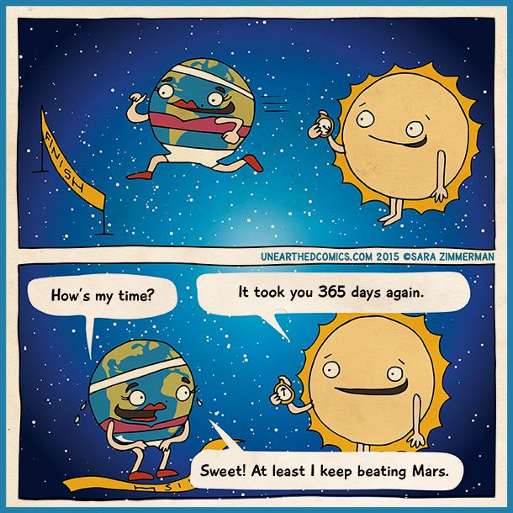
Earth-Space Science Review
Room 241
Adams and Rubin
Learn the mysteries of the universe!
Saturday April 18th 9:00 AM to 12:00 PM
Out of this world review!

Slide 39
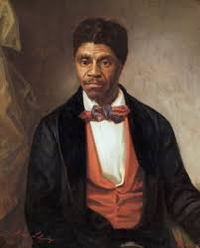
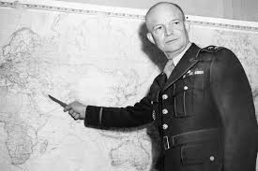



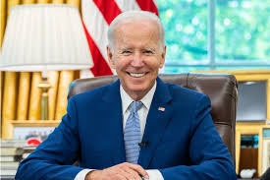

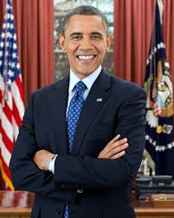

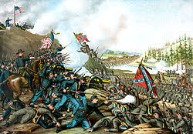
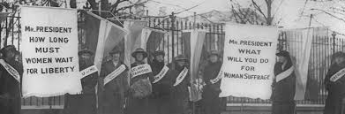

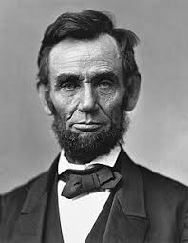

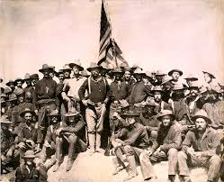
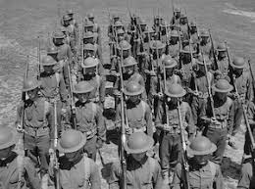
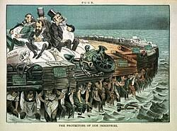



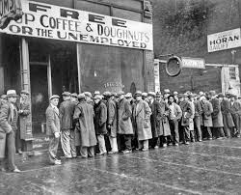

KYRYLIW’S US HISTORY EOC PREP SCHEDULE
Saturday 4/18 from 12-2pm
Saturday 4/25 from 11-1pm
Afterschool:
Monday April 27 4-5:15pm
Tuesday April 28 4-5:15pm
Wednesday April 29th 4-5:15pm
Thursday, April 30th 4-5:15pm
Wednesday, May 6th 4-5:15pm
Thursday, May 7th 4-5:15pm
Friday. May 8th 4-5:15pm
Monday, May 11th 4-5:15pm
Tuesday, May 12th 4-5:15pm
Thursday, May 14th 4-5:15pm

Slide 40
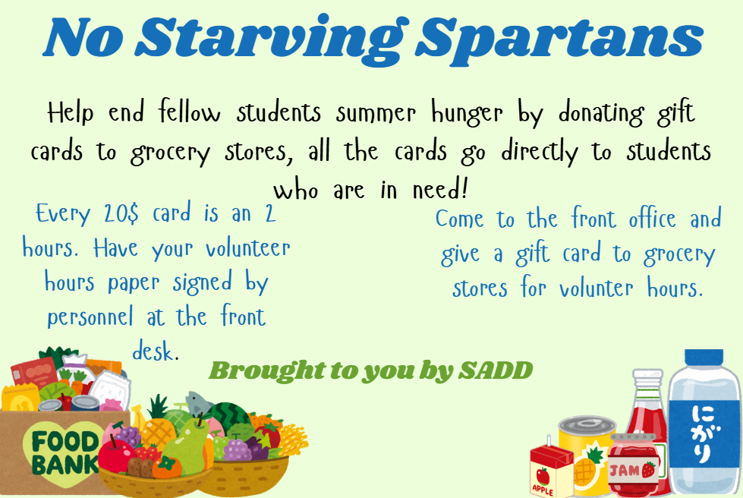

Slide 41
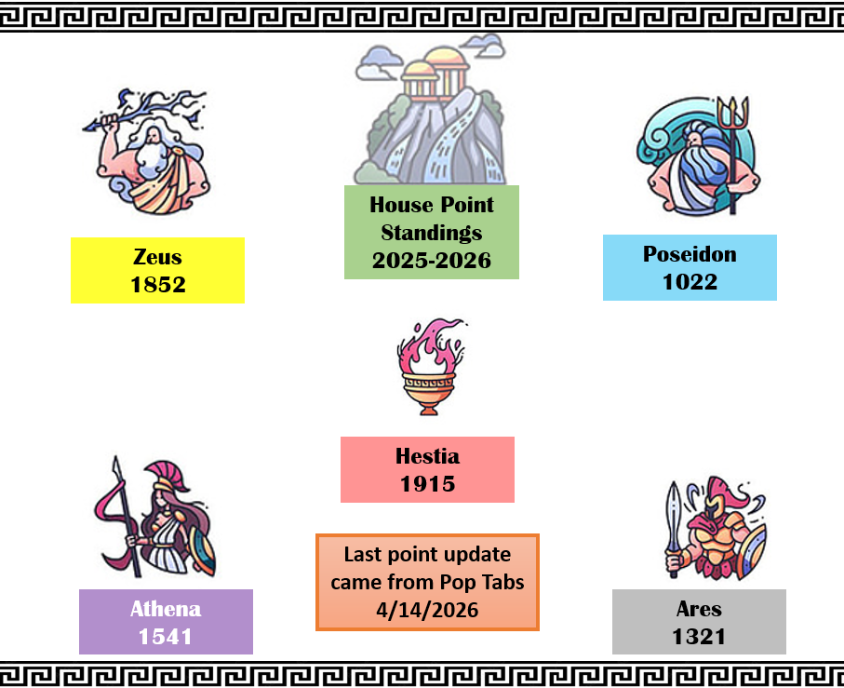

Slide 42
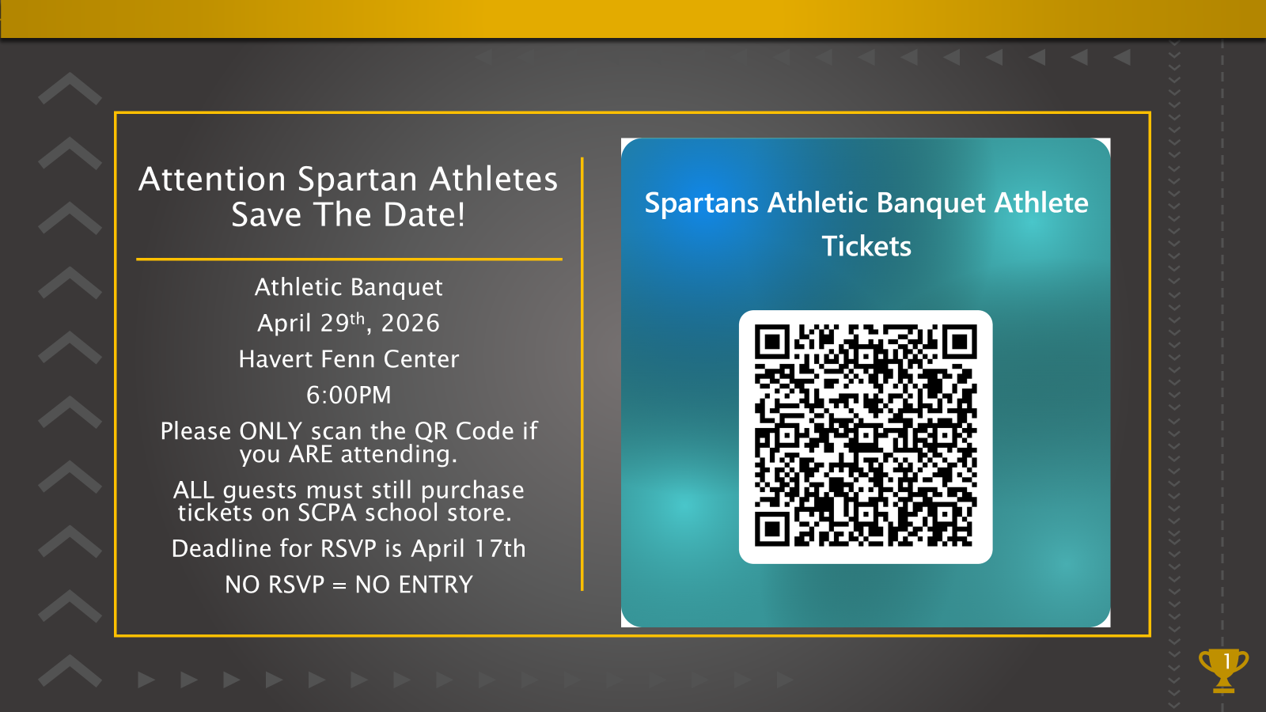

Slide 43


Slide 44
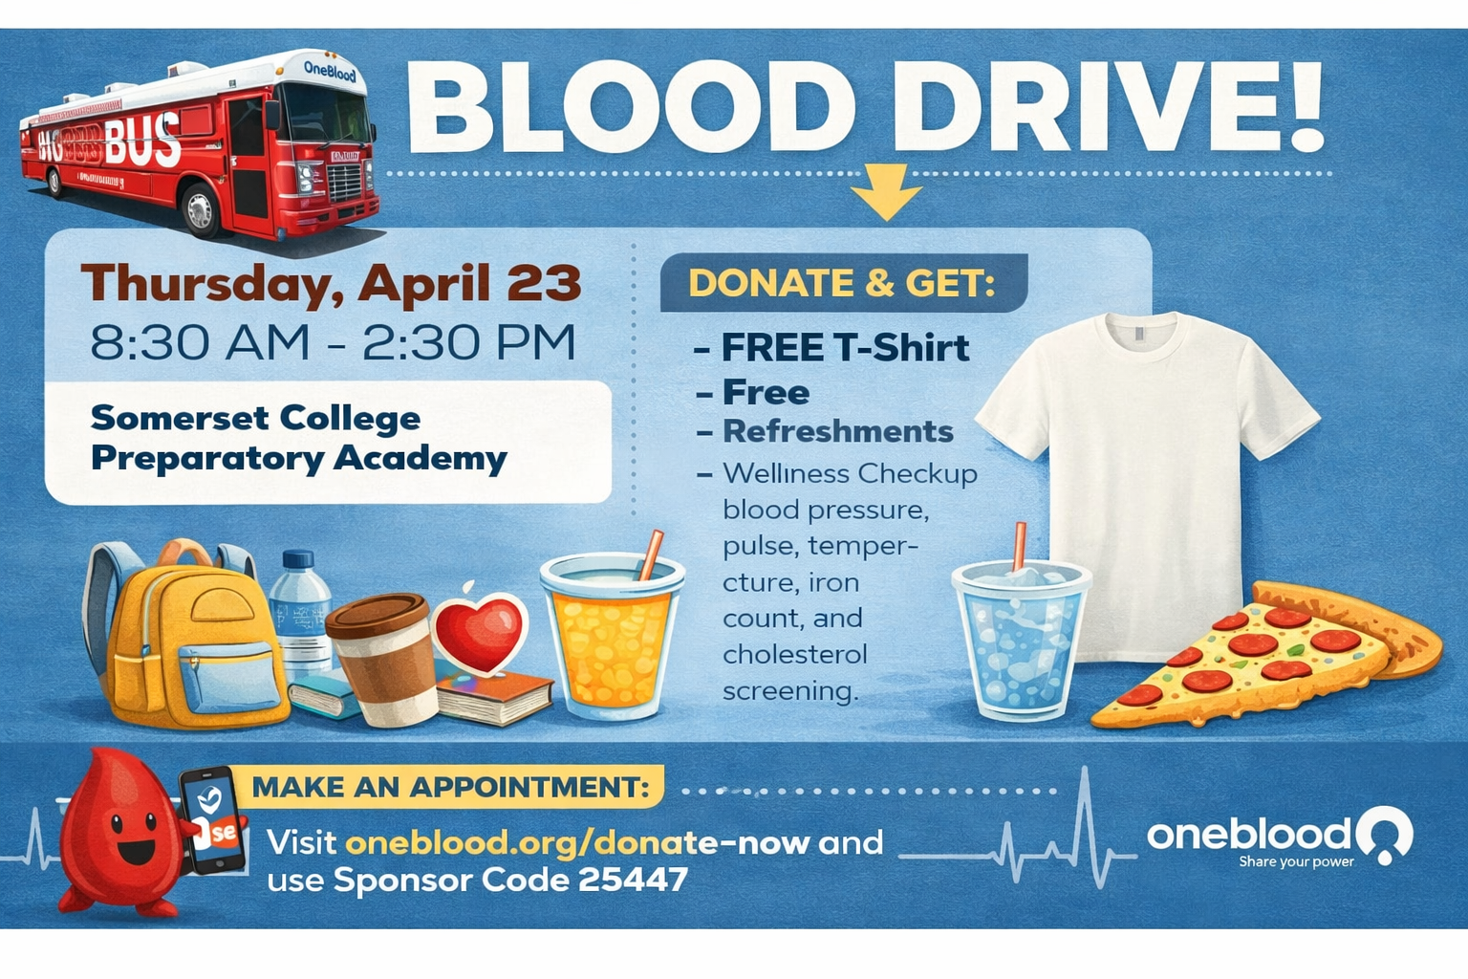

Slide 45


Slide 46


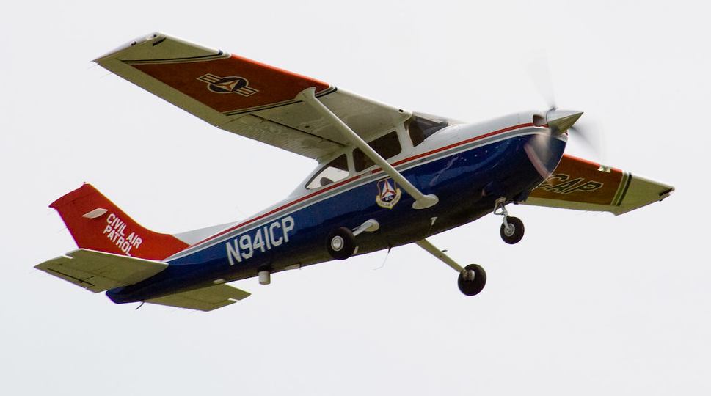
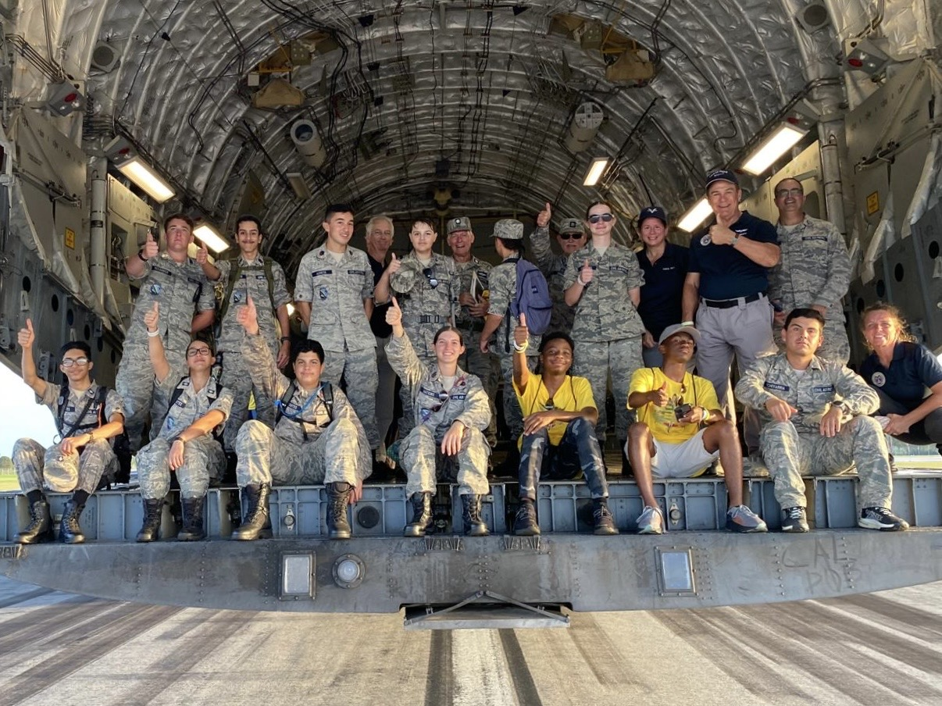

Are you interested in
Aerospace, Leadership, or Emergency Services?
Welcome to the Civil Air Patrol!
The Civil Air Patrol offers..
Free Orientation Flights
Help prepare you for the Air Force
Teamwork and Leadership skills
Air force like environment
Stem-kit programs and education
Scholarship opportunities and more!
Contact our squadron commander Sonya Milu at: Sonya.milu@flwgcap.us
You are welcome to join us
Tuesdays, 7:00 pm
IRSC Chastain Campus Building B
2400 SE Salerno Rd.
Stuart FL. 34997

Slide 47


Slide 48

Chess Club & Movie Club Canceled
April 13th – April 24th

Slide 49

Dungeons & Dragons Club
READY FOR ADVENTURE, THRILLS, AND FANTASY?
D&D CLUB MEETINGS
MONDAYS AT 3:50 TO 5:15 PM
ROOM 175

Slide 50

Interested in starting a school club?
If you’re interested in starting a school club, you should do the following:
Find a teacher to sponsor the club. Give them the details about the club so they know if they’re able to sponsor the club.
Create a petition and get students who would be interested in your club to sign it. This shows that your club has generated interest.
Talk to someone in administration about getting your club approved. Tell them who the sponsor is, when the club will occur (lunch or afterschool), and what the club entails.
Email Mr. Kyryliw (Kyryliw.Michael@somersetcollegeprep.org) the information about you club and a slide advertising it. I will leave the advertising slide up for a week or so and create a slide listing all the club information for easy reference.

Slide 51
School Club List
Monday
Chorus (High School)- afterschool from 4-5:30
Dungeons and Dragons- afterschool, in 175c, from 3:50-5:15
Disney Channel Club- at lunch, in 249B
Library- at lunch, in 232A
Tuesday
K-Pop- at lunch, in 230A
Chess Club- at lunch, in 134
Drama- afterschool in 167c, 4-5pm
Gaming Club- afterschool, from 3:45-5pm in 276c
Guitar Club- afterschool, from 4-5pm in 169c
Salsa and Bachata- at lunch, 136A
Library- at lunch, in 232A
Wednesday
SGA- Afterschool at 4pm
First Priority- at lunch in the gym
Crochet Club
Odyssey of the Mind- at lunch, in 276C
Debate Club- at lunch, in 129A
Library- at lunch, in 232A
Thursday
Artists for a Cause- at lunch, in 268c
Future Builders of America- at lunch in 175c
Prom Committee/Planning- 276A at lunch
Computer Science Club- at lunch in 128A
Guitar Club- afterschool, from 4-5pm in 169c
Salsa and Bachata- at lunch, 136A
Library- at lunch, in 232A
Friday
Movie Club- at lunch, in 134A
Gay-Straight Alliance- at lunch, in 169c
Middle School Science Olympiad at lunch, in 245B
Disney Channel Club- at lunch, in 249B
Astronomy Club- at lunch, in 247B
Creative Writing- at lunch, in 167C
Library- at lunch, in 232A

